Slide 1
Welcome to Demo Day!
Prof. Dr. Dirk Riehle
Friedrich-Alexander University Erlangen-Nürnberg
AMOS I01
Licensed under CC BY 4.0 International
Notes:
It is Friedrich-Alexander University Erlangen-Nürnberg – FAU, in short.
Corporate identity wants us to say “Friedrich-Alexander University”.

Slide 2
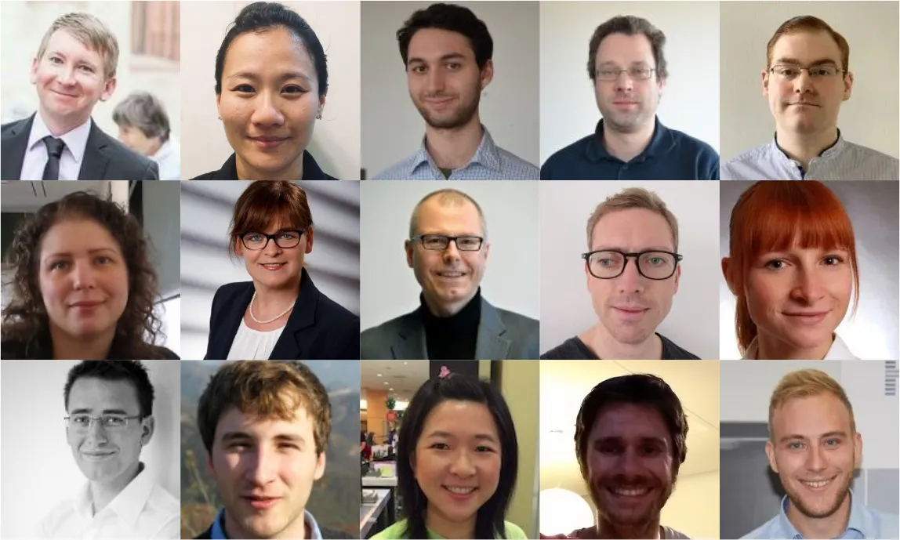
The Professorship for Open Source Software

Slide 3



















Industry Partners and Teaching Projects
...

Slide 4
The 2021 AMOS Projects
EMBA Service (with Siemens Energy)
Context Map for Corporate Data (with CPU 24x7)
Synthetic File System (with GRAU DATA)
Inner Source Project Linter (with DATEV)
3D Viewer (with Büren & Partner)
Neural Network Enablement (with Huawei)
Bike Nest (with Markus Stipp, entrepreneur)
Carbon Footprint Visualization (with Siemens Energy)
Notes:
These are the available projects; at start of course, students will already have been assigned to teams and projects.

Slide 5
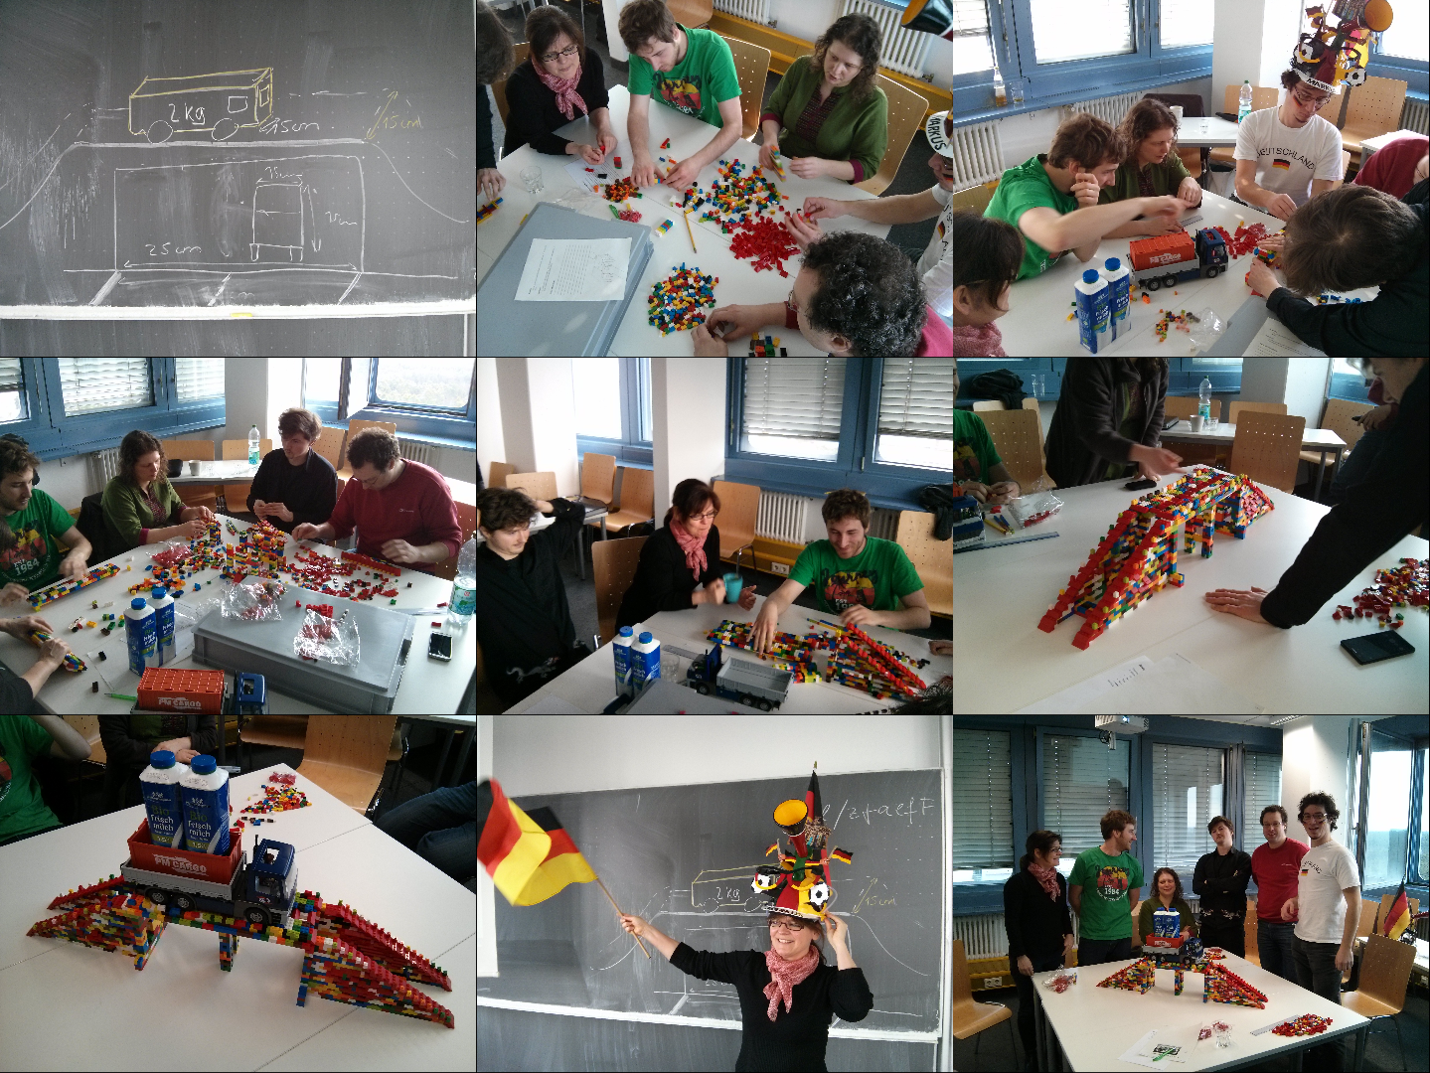

Slide 6
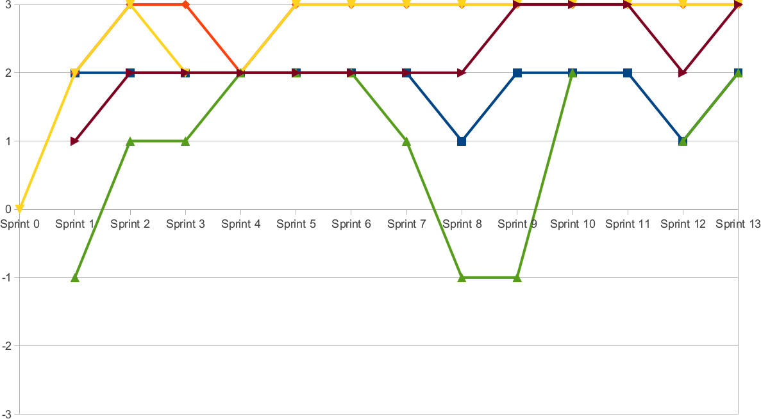
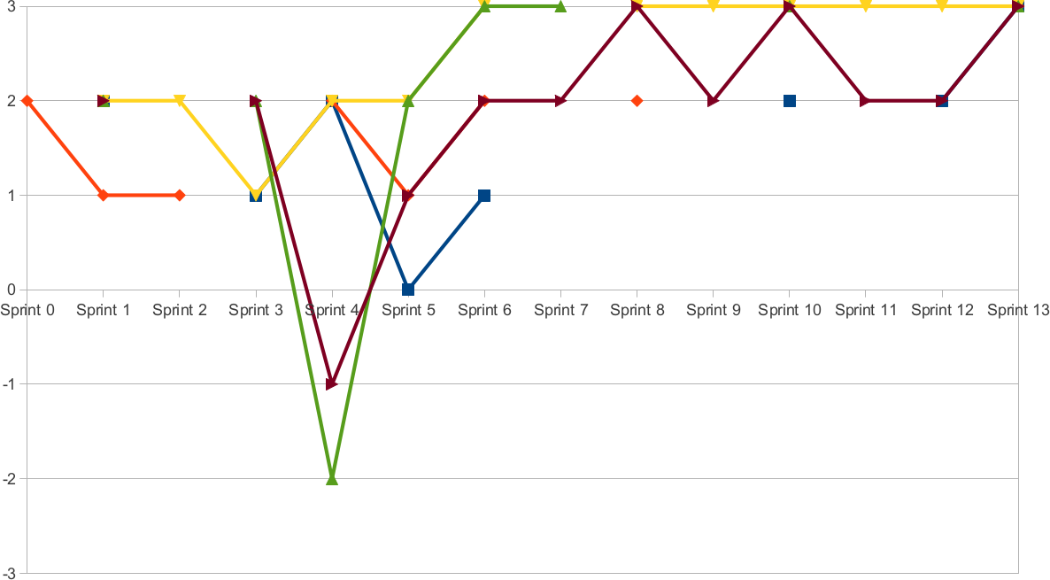
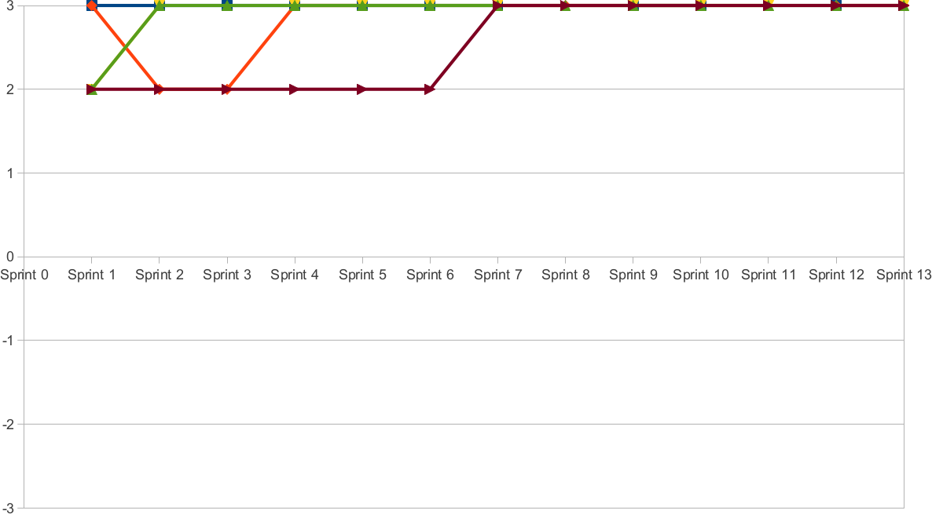

Slide 7
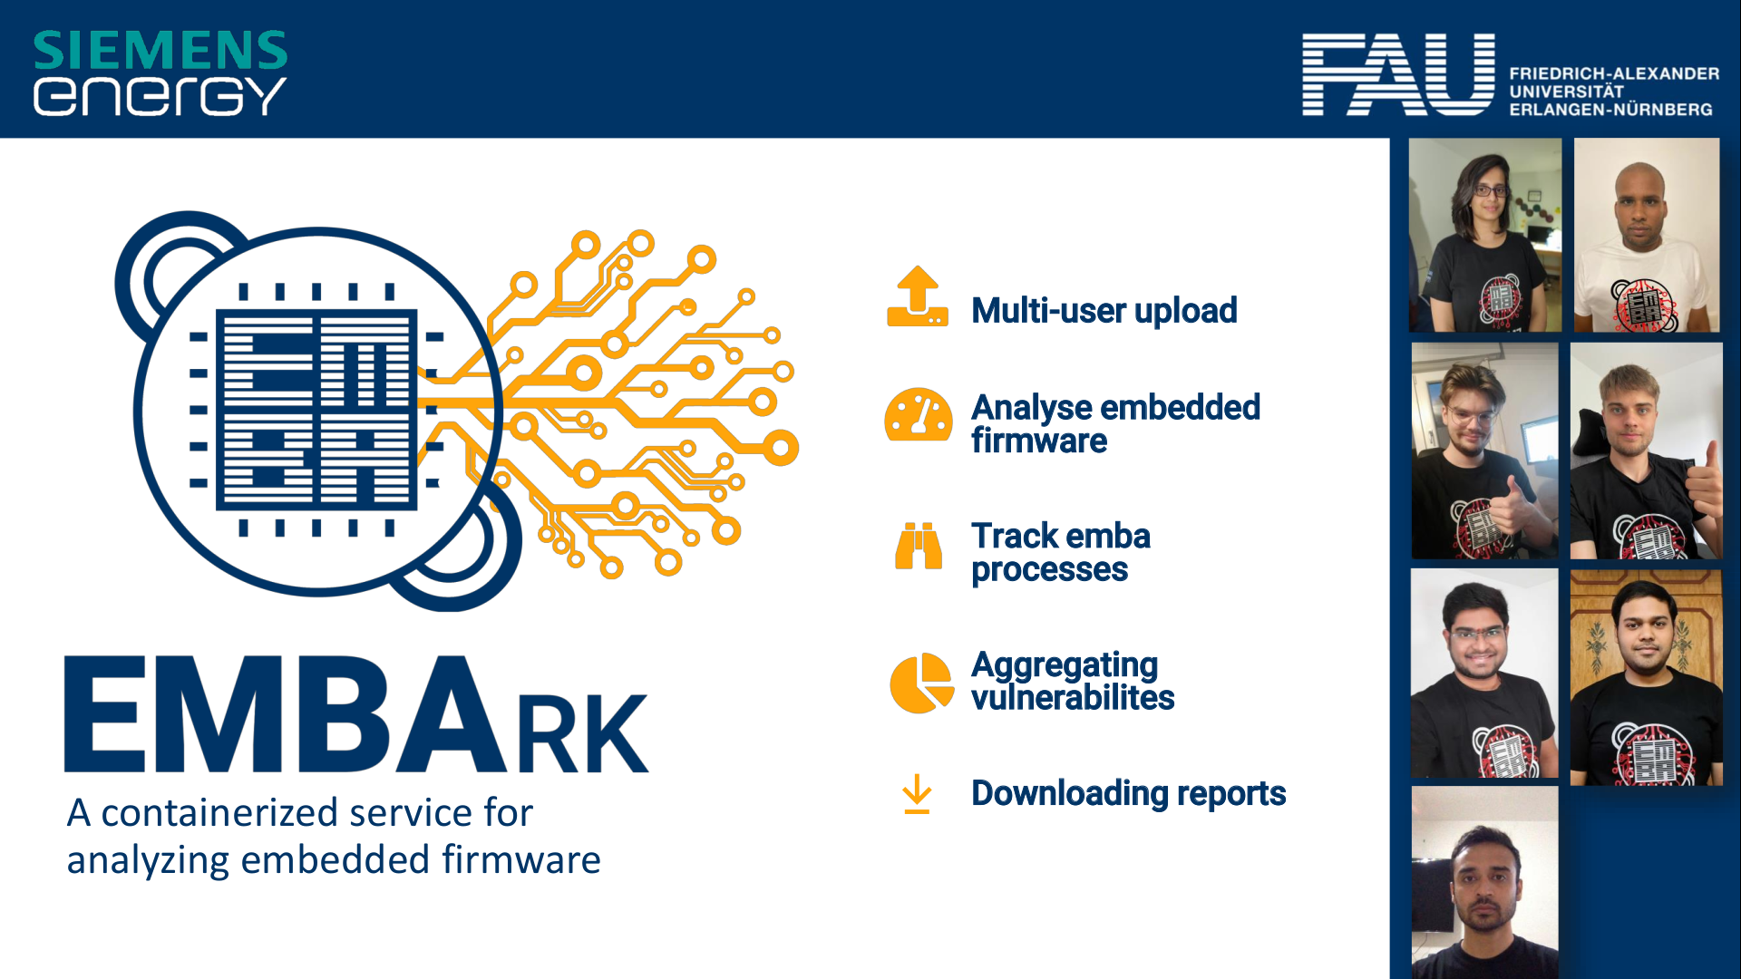
Project 1 slide

Slide 8
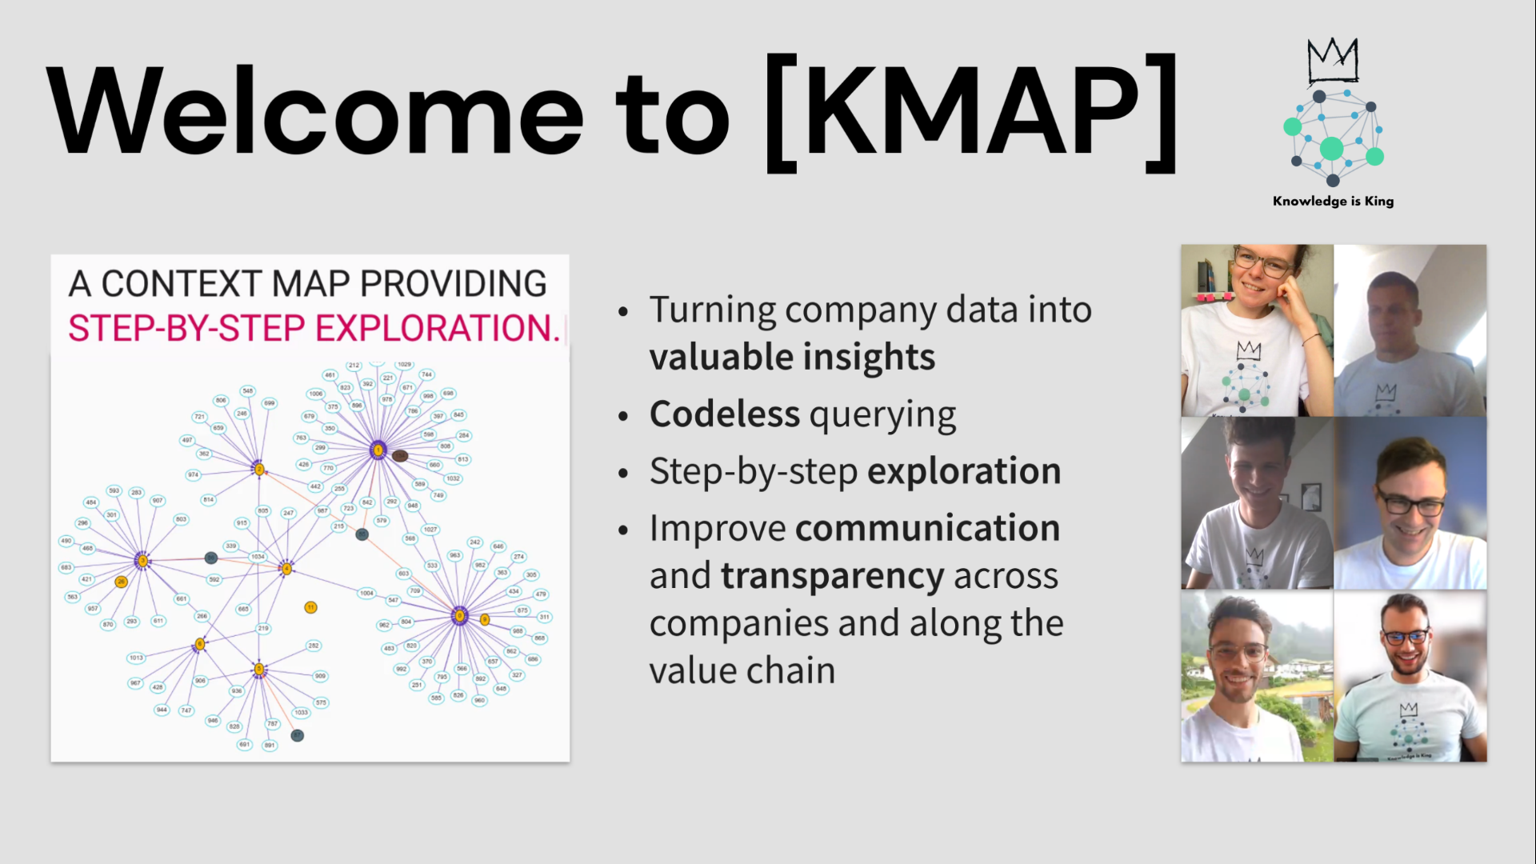
Project 2 slide

Slide 9
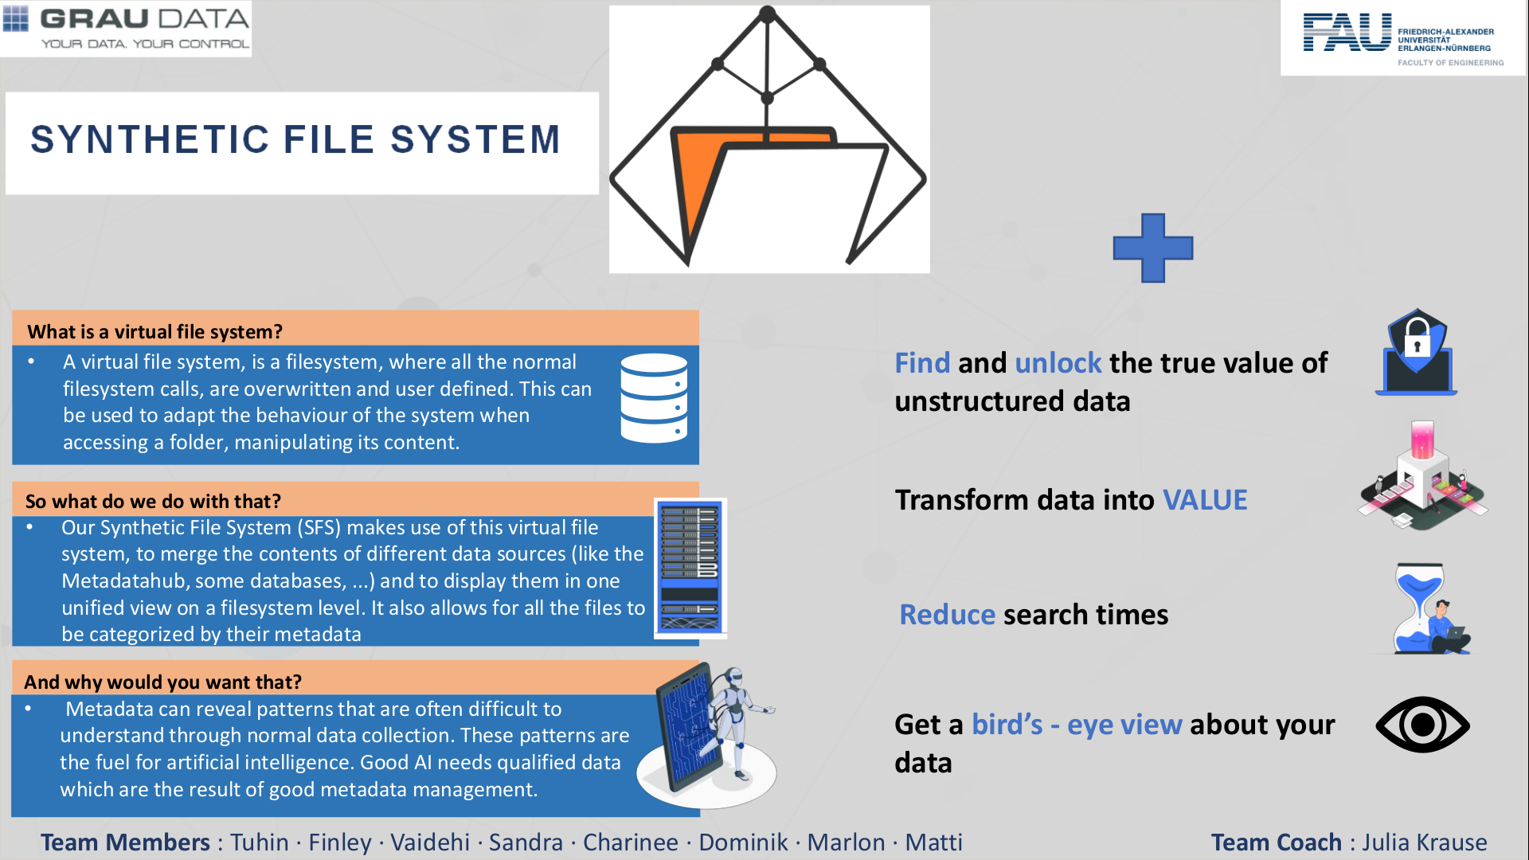
Project 3 slide

Slide 10
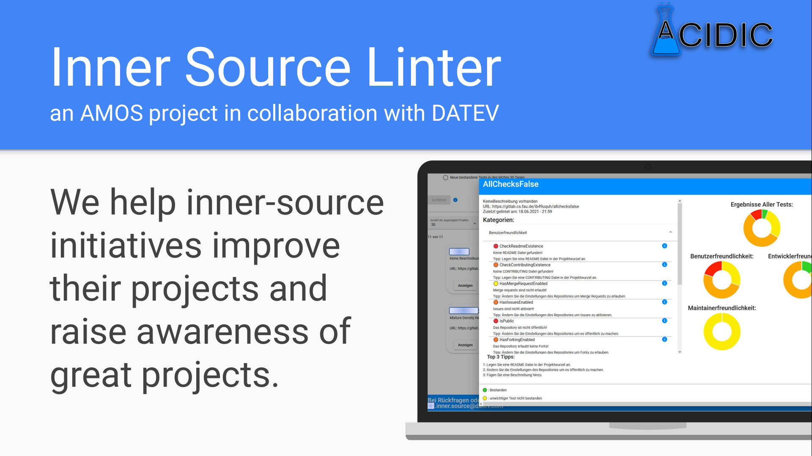

Slide 11
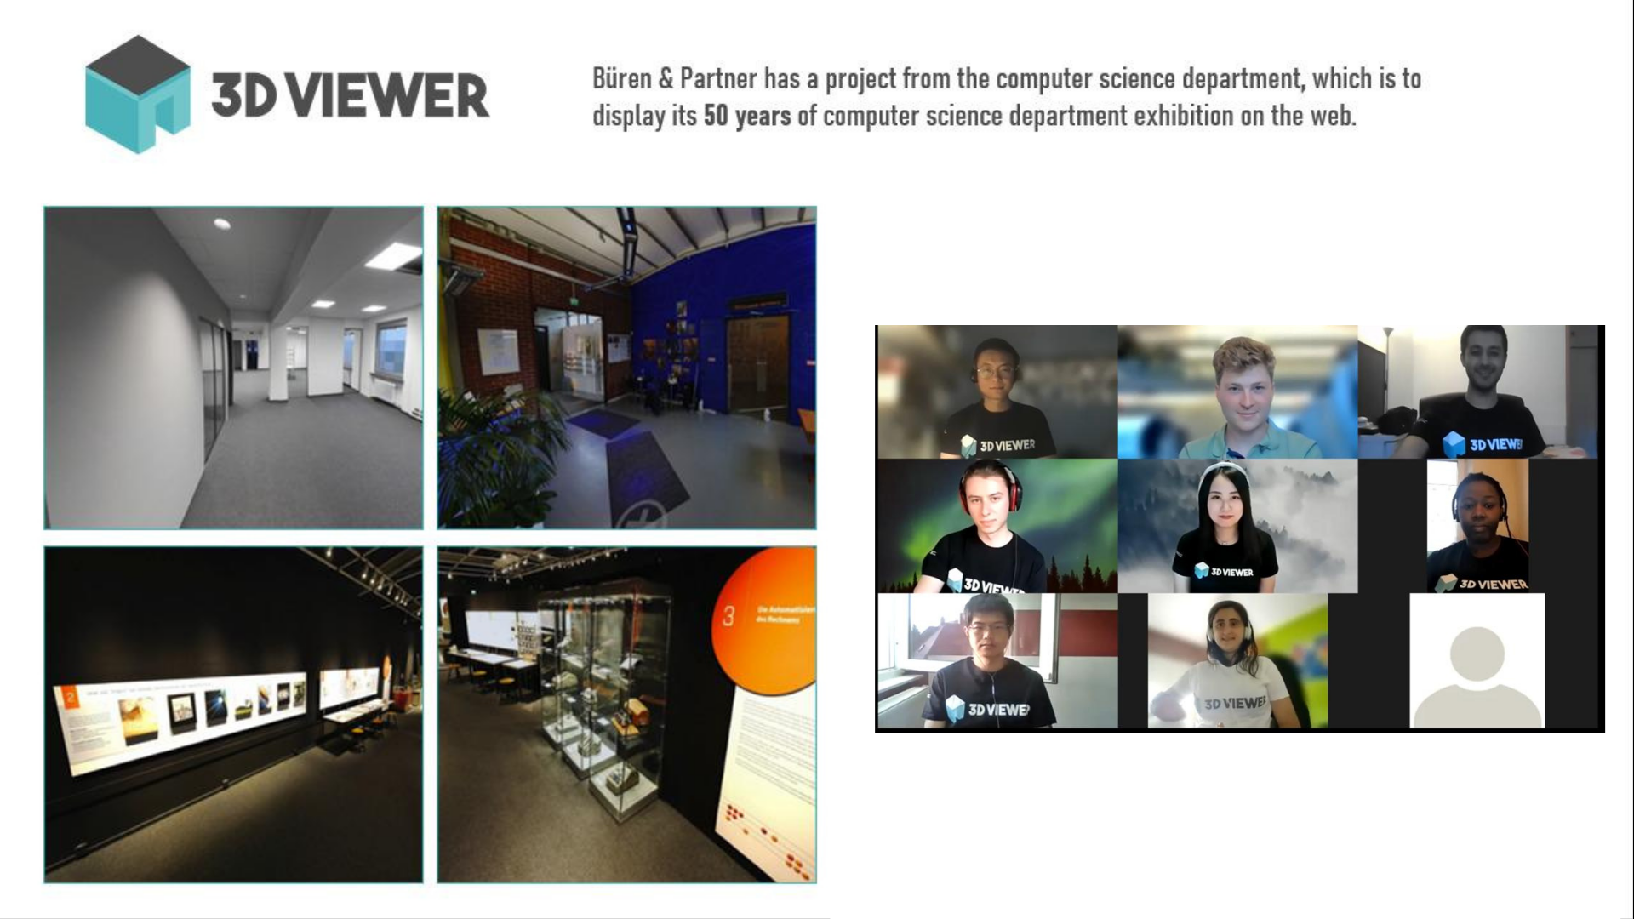
3D Viewer

Slide 12
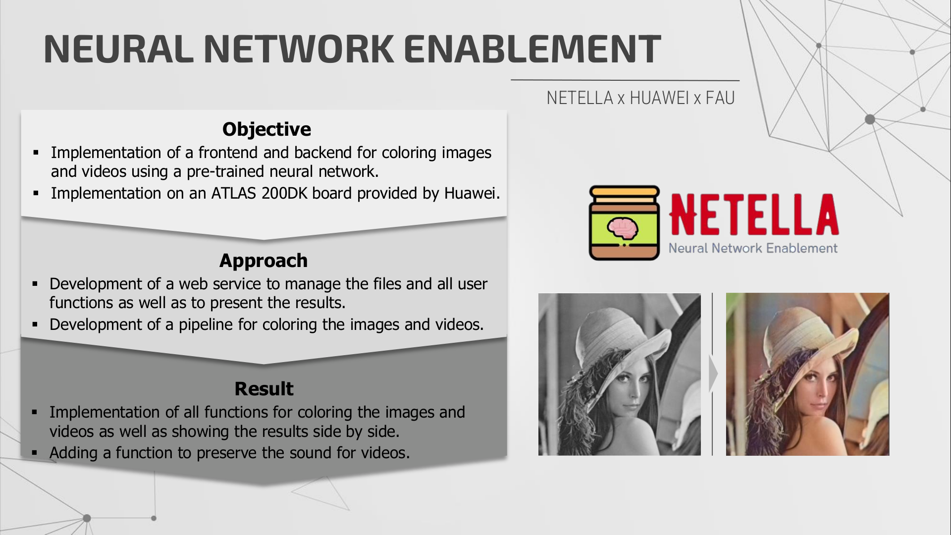

Slide 13
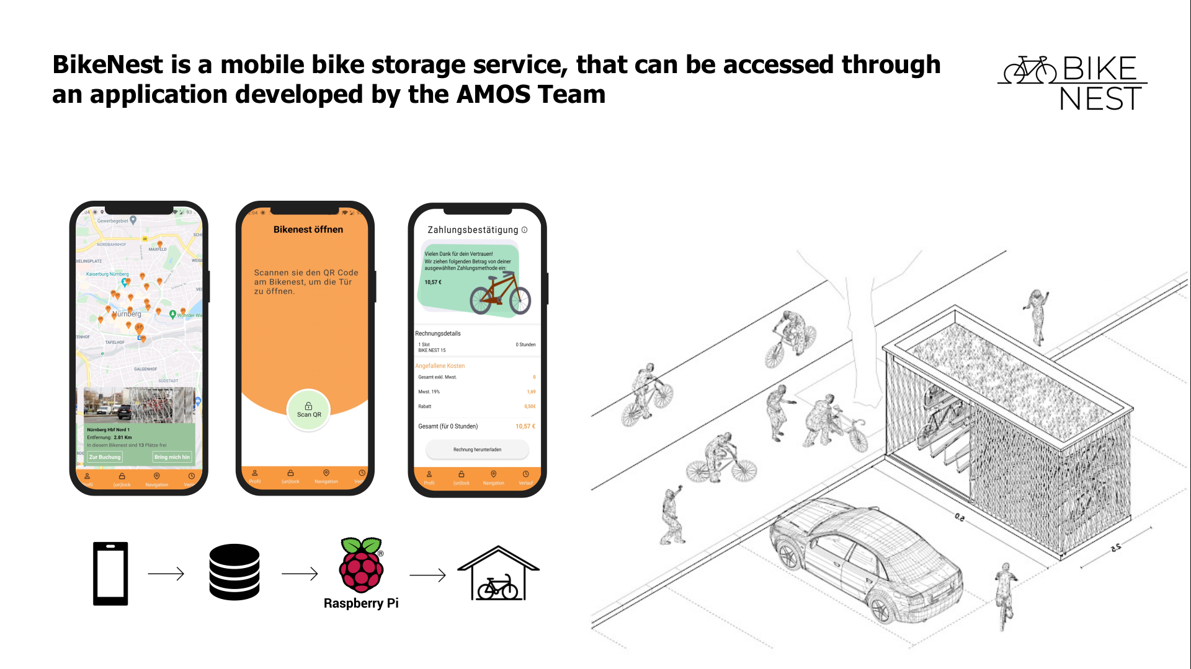

Slide 14
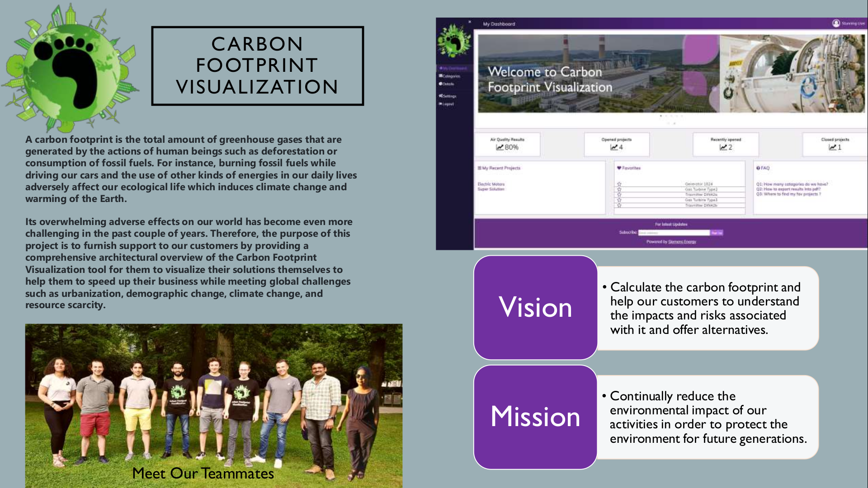

Slide 15
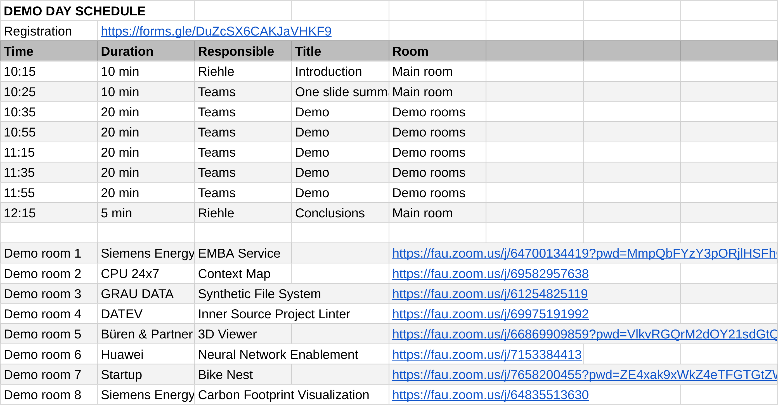
AMOS Demo Day Schedule at https://oss.cs.fau.de

Slide 16
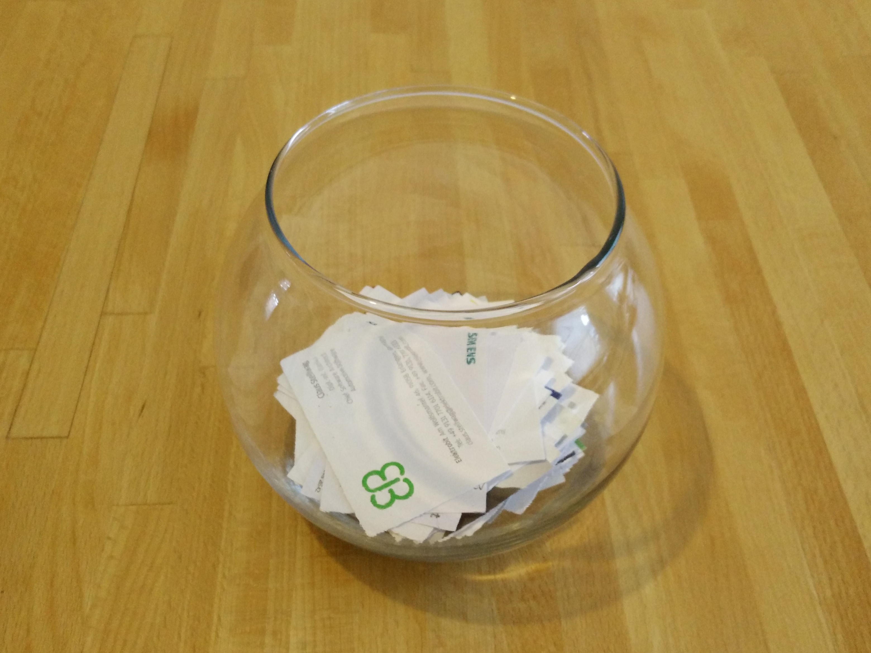

Slide 17
Thank you! Questions?
dirk.riehle@fau.de – https://oss.cs.fau.de dirk@riehle.org – https://dirkriehle.com – @dirkriehle
DR

